Slide 1

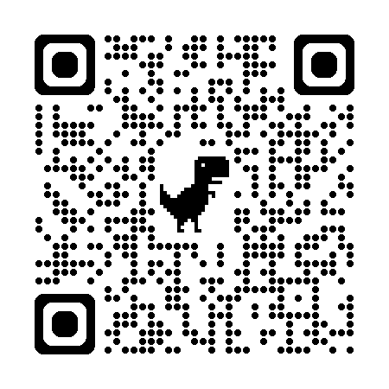
Unite your ebook COUNTER collections data with LC call numbers from WorldCat: an easy DIY workflow
the DESIRE
As a STEM librarian: how much of the ebook content I acquire is being used?
the PROBLEM
Project COUNTER includes use data by title and ISBN, subject id is mineable by titles and publishers.
the INQUIRY
How to bring Library of Congress Classification and Subject Heading data into this picture?
the ANSWER
1. Upload the Project COUNTER ebook use data (csv) into OpenRefine;
2. Within OpenRefine, query the WorldCat API based on ISBNs in COUNTER data;
3. Retrieve and merge WorldCat XML records into COUNTER data;
4. Extract LCC and LCSH from WorldCat XML records per ebook title;
5. Clean data for examination.
the DESIRE | FULL CIRCLE
Work with anyone in your organization with more sophisticated technical aptitude to streamline this endeavor. There are better ways of doing this!
IS THIS IMPORTANT or USEFUL, and WHY?
GitHub
Author: Jennifer Simms, Indiana University Libraries
Image from Adobe Stock, AI generated, IU License, Prompt: Digital Book.

